Slide 1
Predicting Financial values by with Convolutional Neural Network

Slide 2
Table of Contents
Laboratoriess
Multi Layer Perceptron
AGDS
AutoEncoder
Project
Aim
Technologies that are used
$$$ Live Demo $$$

Slide 3
MLP
Basic Operations are implemented as functions
Weigths and the biases from each layer is stored in a dictionary
Tanh and sigmoid functions are used on the neurons
Functions are created to be easy to work on future. (ref: AutoEncoder)
Functions are created to be easily get modified. (One can add layers, neurons super easily)
MinMax Scaling applied

Slide 4
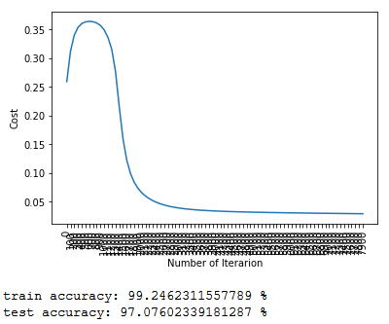
MLP
Breast Cancer Dataset
Code can be found on: www.kaggle.com/efeergun96

Slide 5
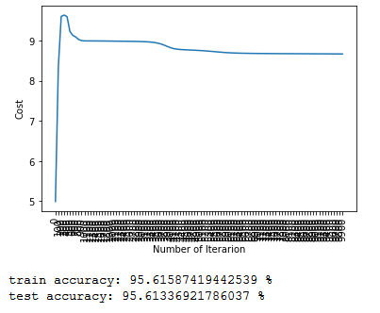
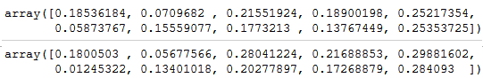
AutoEncoder
The way I created the MLP code made AutoEncoder 10 minutes job!
Almost same code, only change is the prediction method.

Slide 6
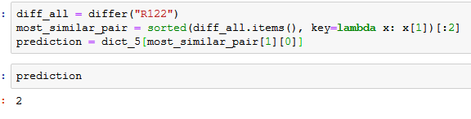
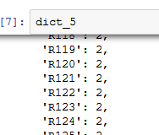
AGDS
Very primitive approach with dictionaries, no visual output, not 100% connected
Works (Manually & Probably not the way it is supposed to be)

Slide 7
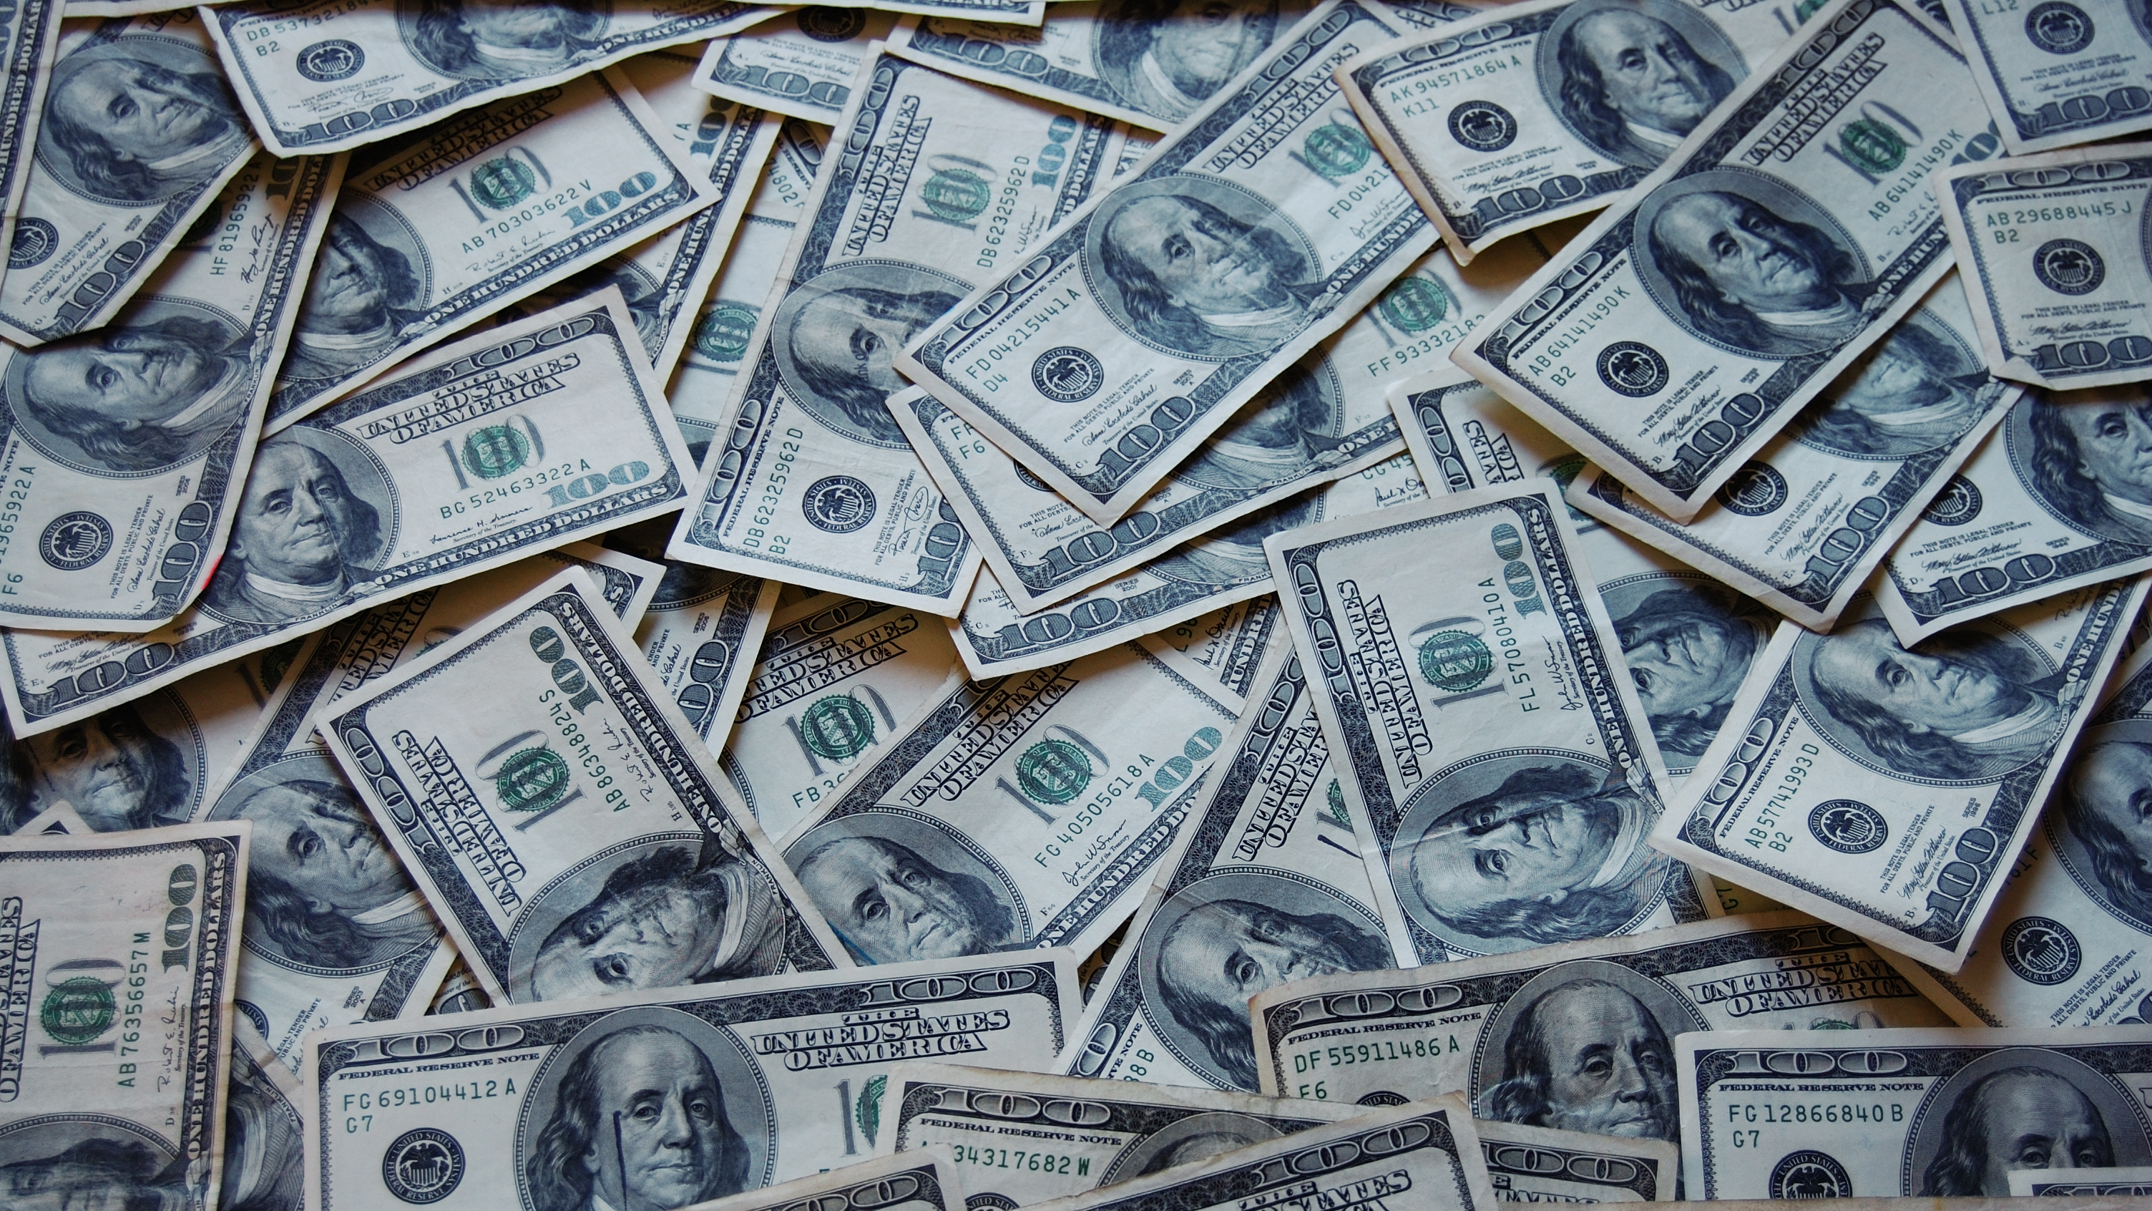
The Project
Aim of this project was using a Convolutional Neural Network to predict financial values(stock prices) of certain stock markets for near future.
Due to the volality and the different nature, stock prices were always considered as unpredictable.

Slide 8
Technologies that I used
Programming Languages
Python
Pascal
Java
Libraries
Keras
Numpy
Yahoo finance
Tools
Jupyter Notebook
Netbeans IDE
Lazarus IDE

Slide 9
The Over-Simplified Plan:
Get the financial time-series data for a good stock
Process the data
Find a good frame size for training and predicting
Create the model
Train the model
Predict future prices

Slide 10
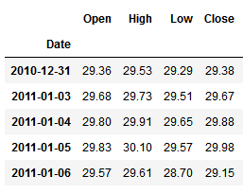
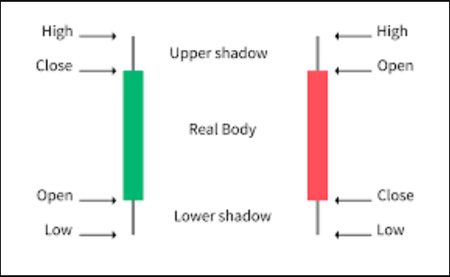
The Data

Slide 11
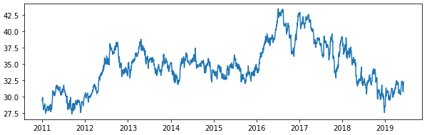
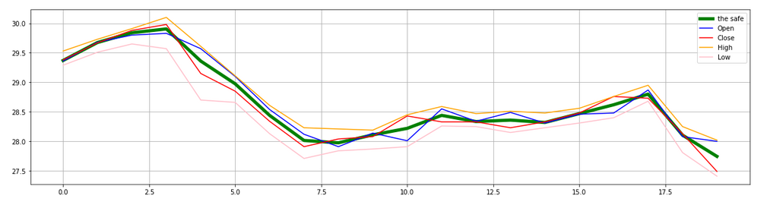
Processing the Data
x 4 ? +1 ?

Slide 12
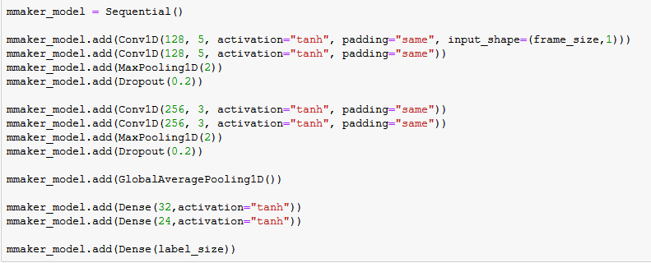
The Model

Slide 13
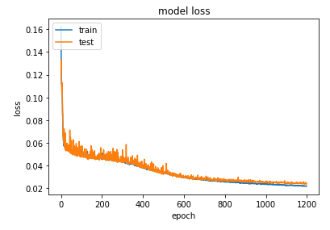
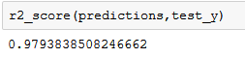
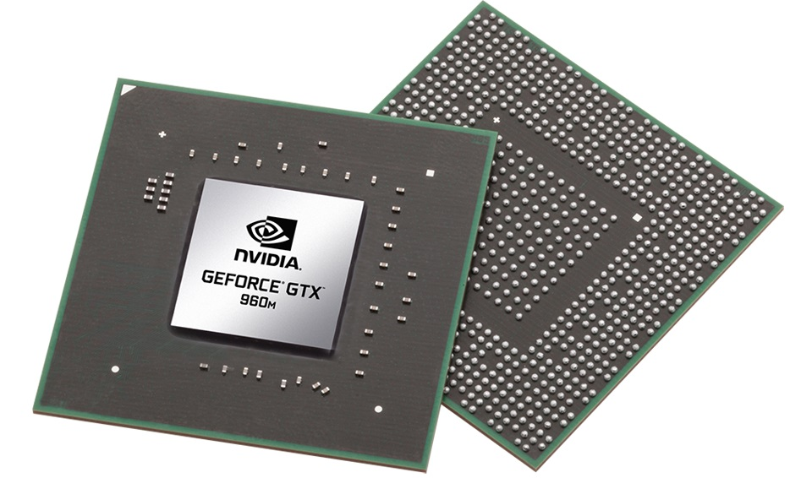
The Model

Slide 14
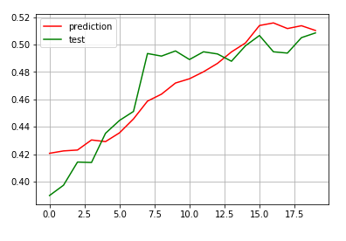
Prediction$

Slide 15
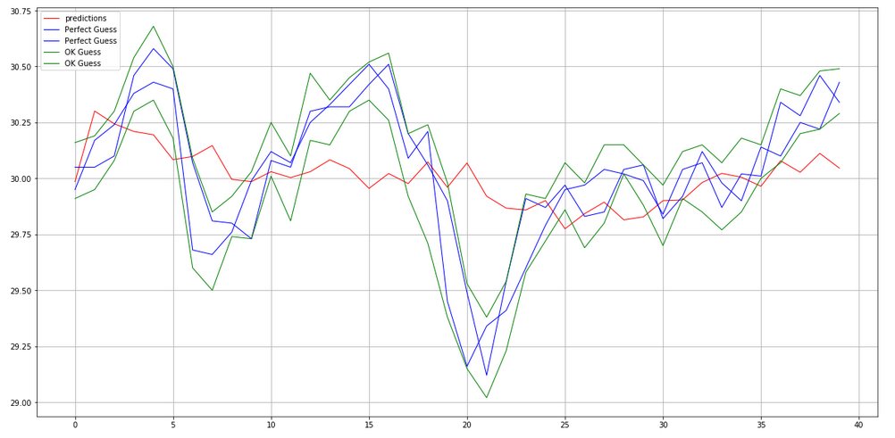
Prediction$

Slide 16
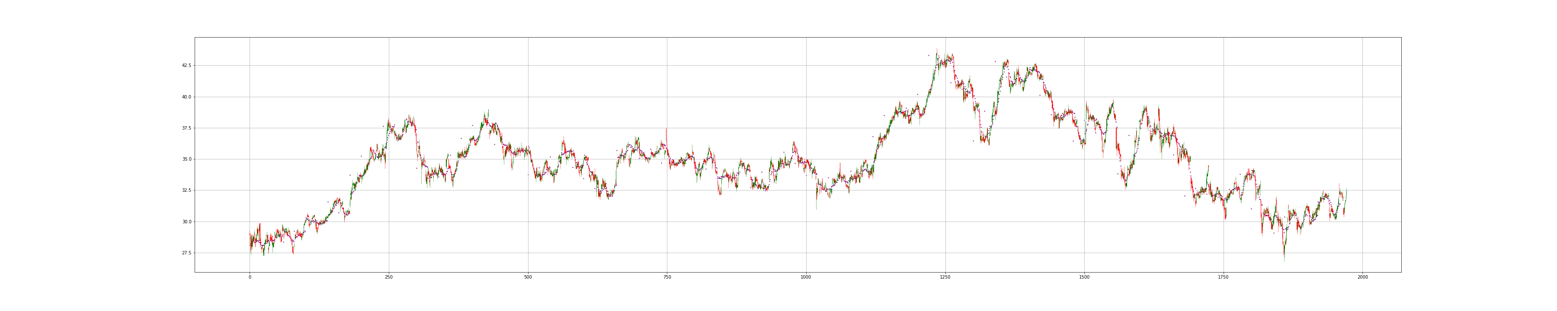
Have a look

Slide 17
Have a look again, maybe come closer?

Slide 18
The App
To make this project better I created a simpe GUI and build a simple pipeline that can predict future prices by using well-trained saved model.
GUI is designed in Java for easiness
Model is already in Python
To combine them, I used Object-Pascal

Slide 19
Live Demo

Slide 20
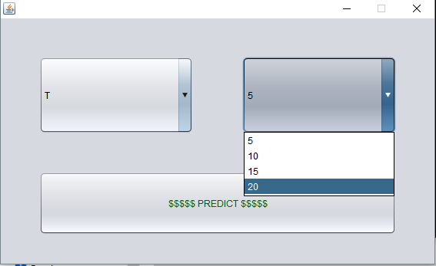
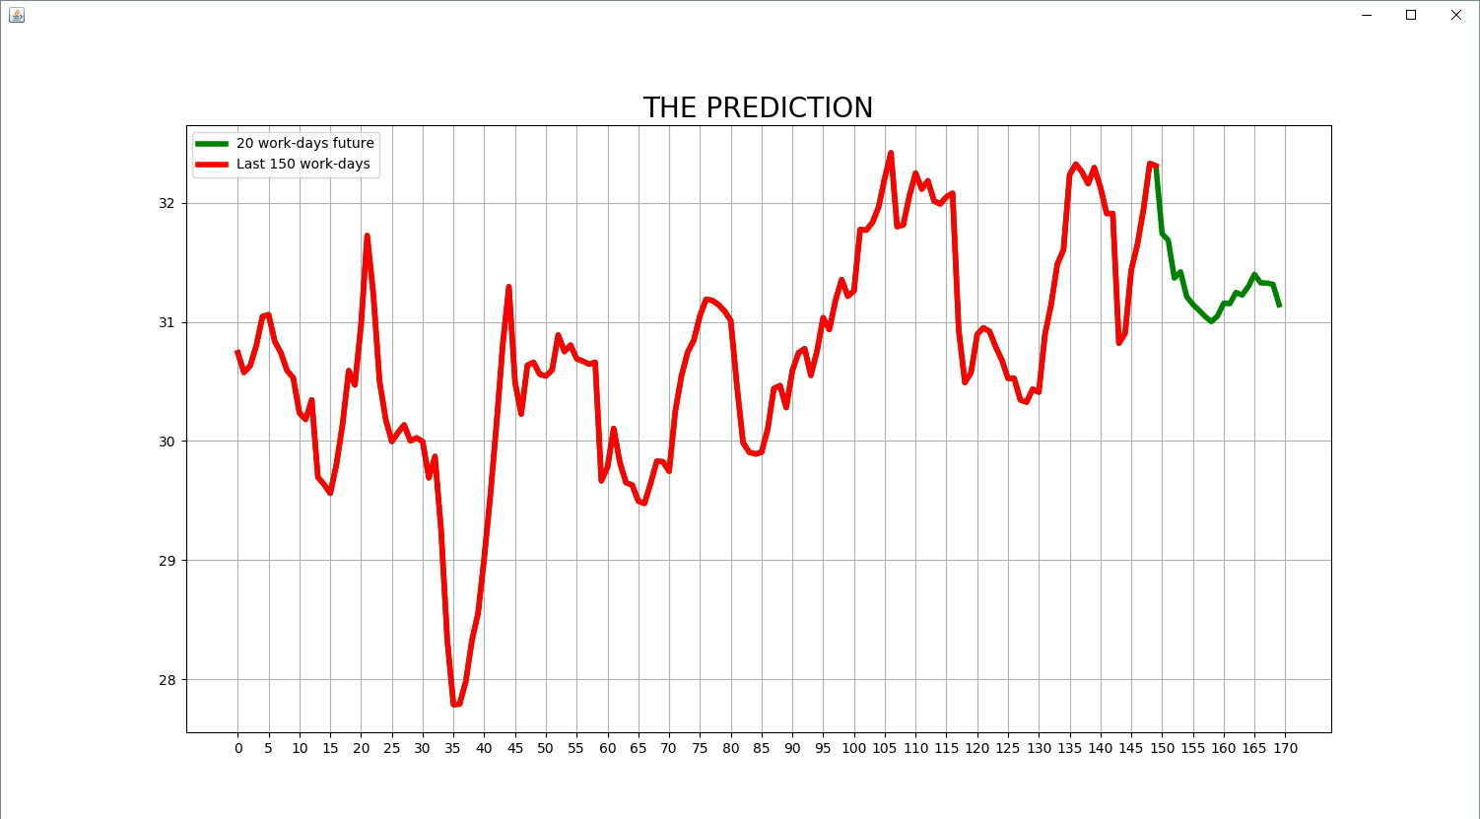
Live Demo

Slide 21
Achievements & Plans
Considerably good score has been reached without using state-of-art LSTM or RNN networks.
One funny app has been created
Increase the Performance
Maybe build some trading Bot

Slide 22
Thanks for listening. Questions?
Efe Ergün

